Slide 1

BERYL8
Service Cloud Use Cases

Slide 2










Beryl8
One of the Largest Salesforce Practices in Asia
200+
100+
~100
60+
9.8 / 10
Success
Projects
Customers
Consultants
Certifications
Customer Satisfaction
Delivered
Company Highlights:
#1 Salesforce Partner in Asia with Branch in San Francisco
Salesforce Gold Partner
1 of 20 Salesforce Resellers globally
The only Partner to deliver an end-to-end solution in Asia (Marketing Cloud, Sales Cloud, Service Cloud, Community Cloud, and App Cloud)
9.8 /10 Customer Satisfaction as rated by our client

Slide 3
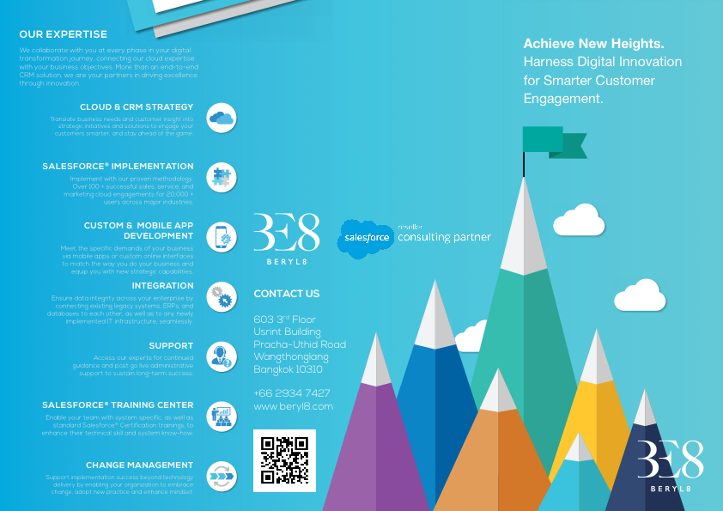

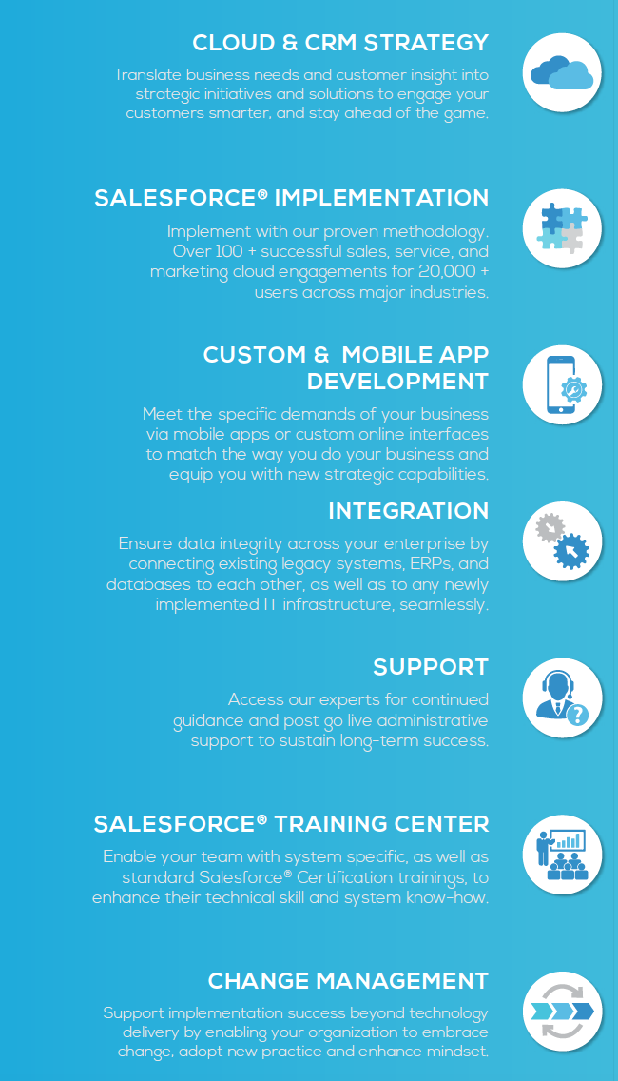



OUR EXPERTISE
We collaborate with you at every phase in your digital transformation journey, connecting our cloud expertise with your business objectives. More than an end-to-end CRM solution, we are your partners in driving excellence through innovation.
CLOUD & CRM STRATEGY
SALESFORCE.COM IMPLEMENTATION
CUSTOM & MOBILE APP DEVELOPMENT
INTEGRATION
SUPPORT
SALESFORCE.COM TRAINING CENTER
CHANGE MANAGEMENT
Notes:
Specialize in SF only, Enterprise comes, high growth, repeat customers, double sales every year
One of the largest SF partners in Asia (ex Japan, Korea)
Platinum Cloud Partner → less than 15 partners world wide
Extended office in San Francisco – consulting for Google currently
Over 50 consultants focus only on Salesforce
Expecting to reach 100 consultants in 2016
In TH – implement for SCB, Kbank, KTB, Thanachart, SCCC, Jack Chia
ISV – Independent Software Vendor – build on the Salesforce platform (Integra8t)

Slide 4





ANANTARA VACATION CLUB
Points based
30 Years
Points differ based on room type/ season/
location
Flexibility

Slide 5


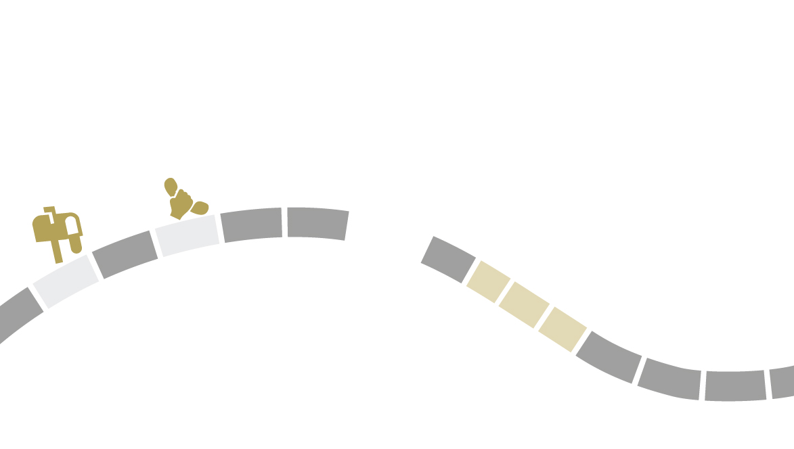
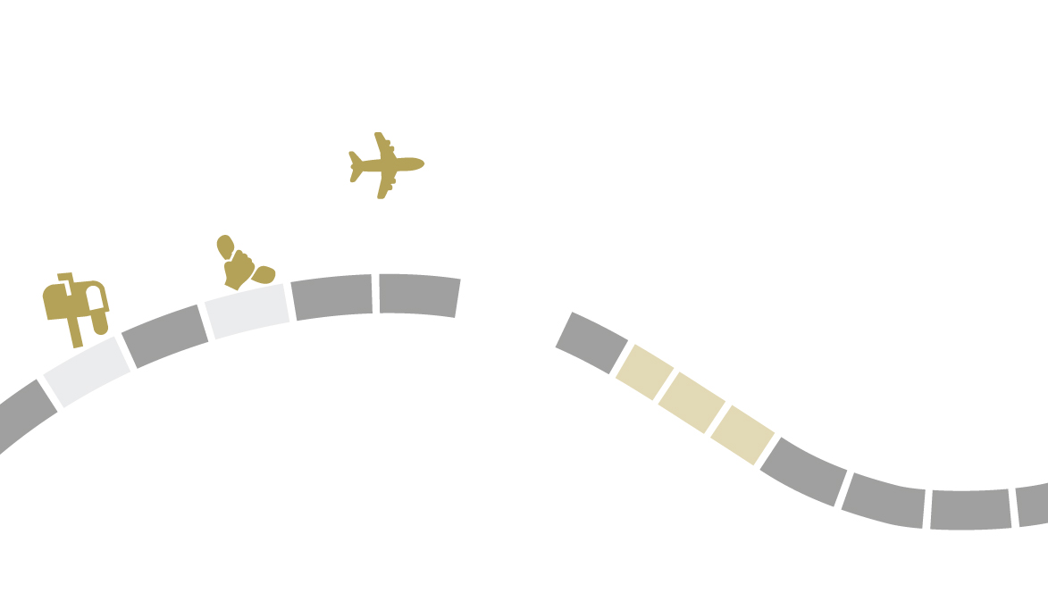

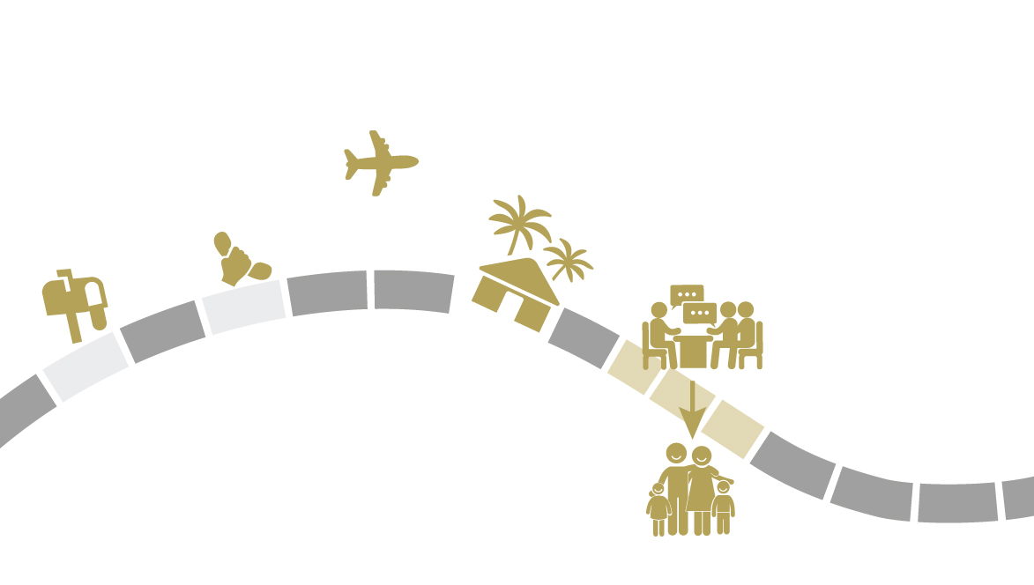

HOW DO CUSTOMERS JOIN THE CLUB?

Slide 6
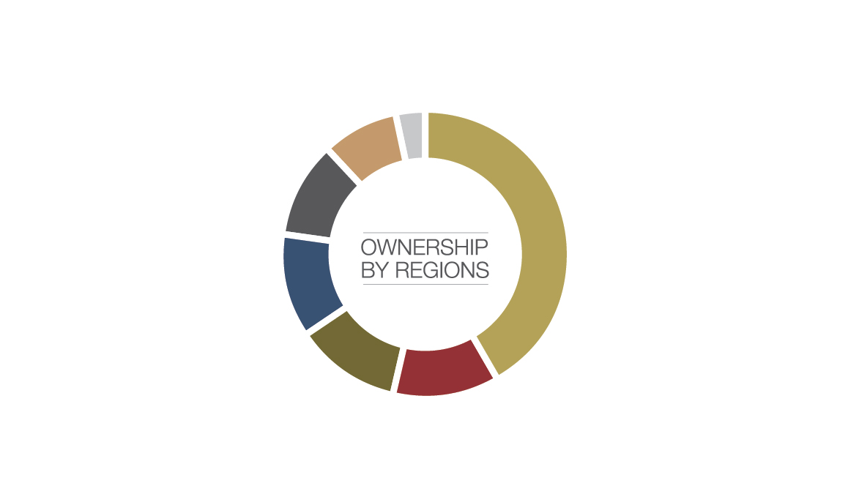
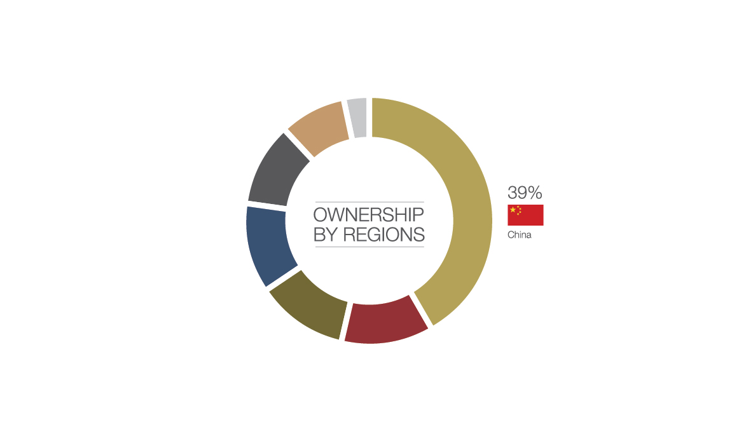
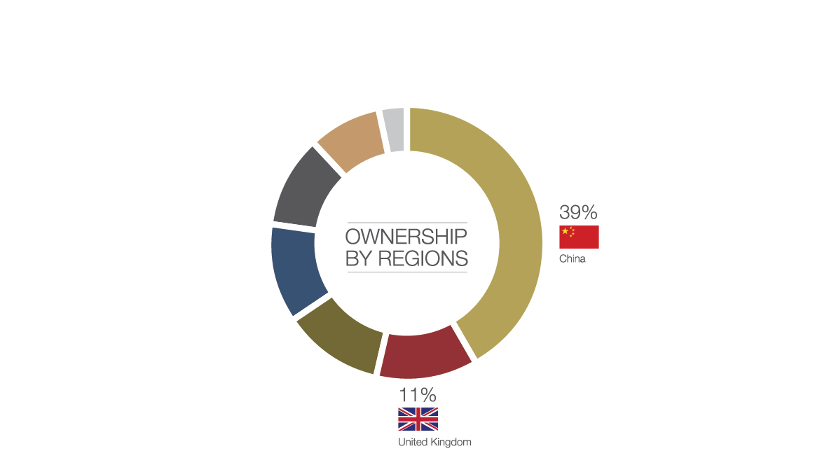
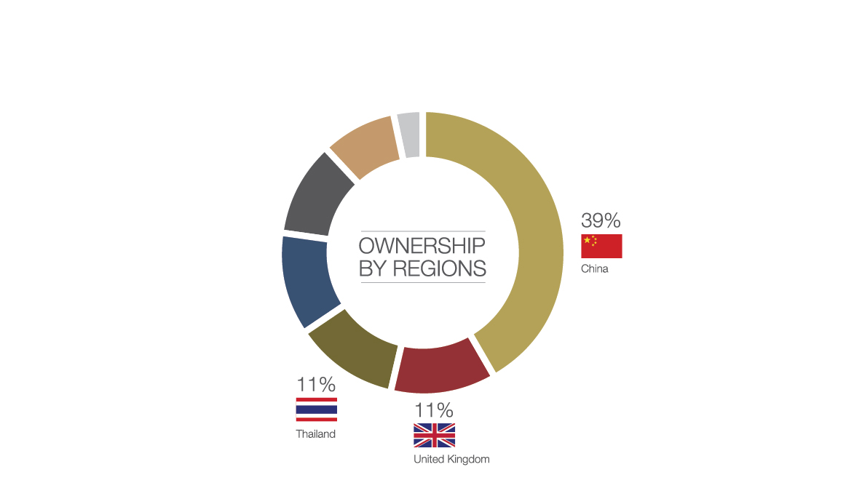
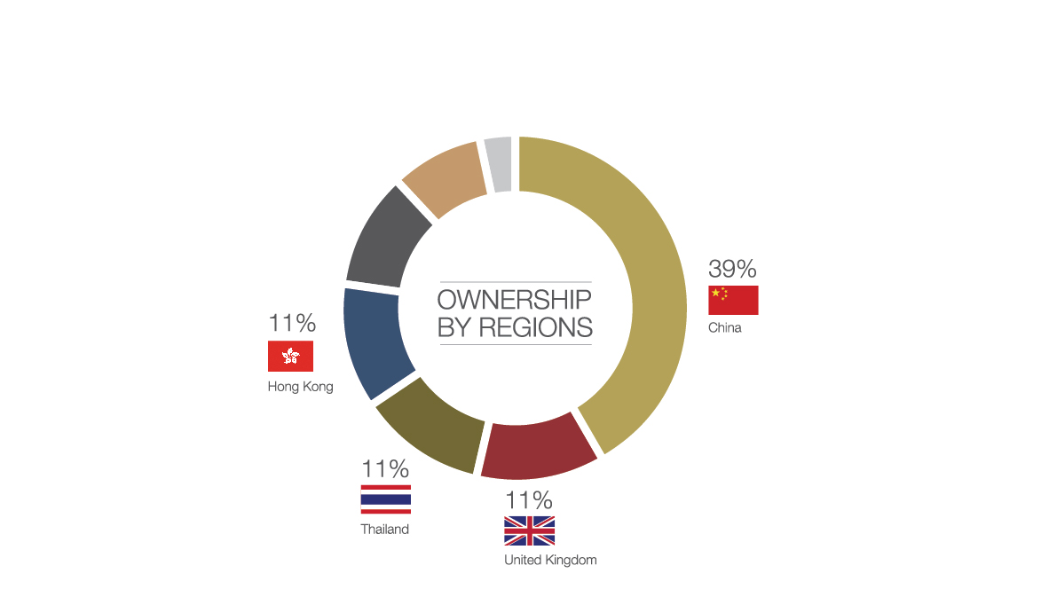
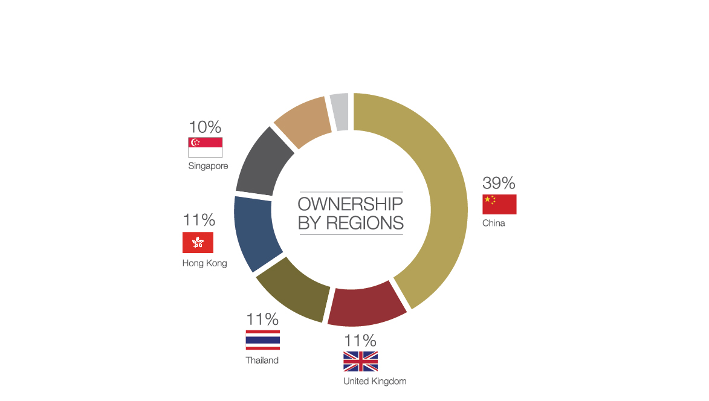
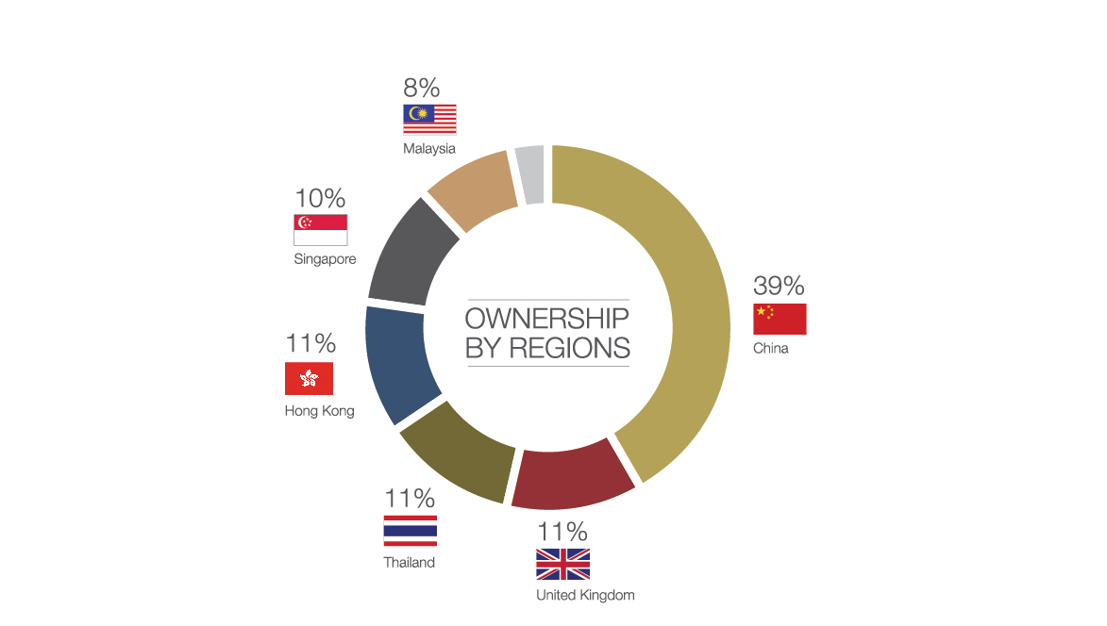
WHERE DO OUR CUSTOMERS COME FROM?

Slide 7


Club Services
Servicing a portfolio of owners valued at more than US$192 million
Reserving more than 50,000 room nights a year in more than 100 resorts
Service in more than 7 languages

Slide 8
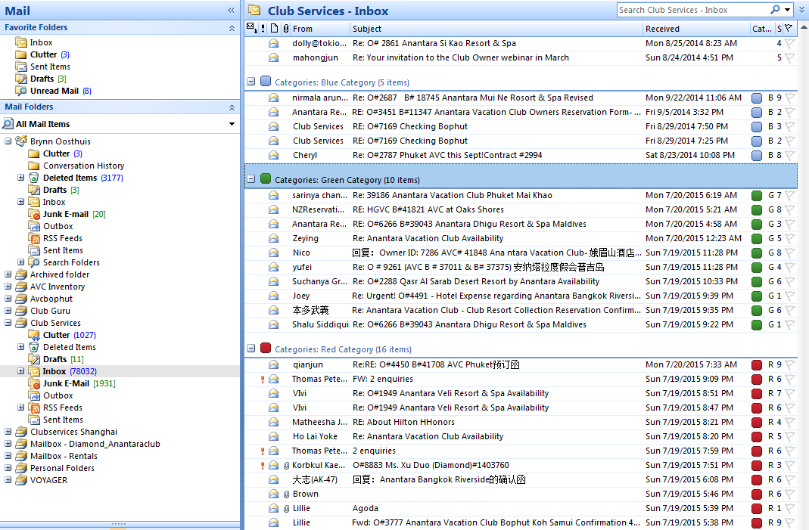

How we operated BEFORE Salesforce?

Slide 9

How we operated BEFORE Salesforce?

Slide 10

Introduction of salesforce in July 2014

Slide 11
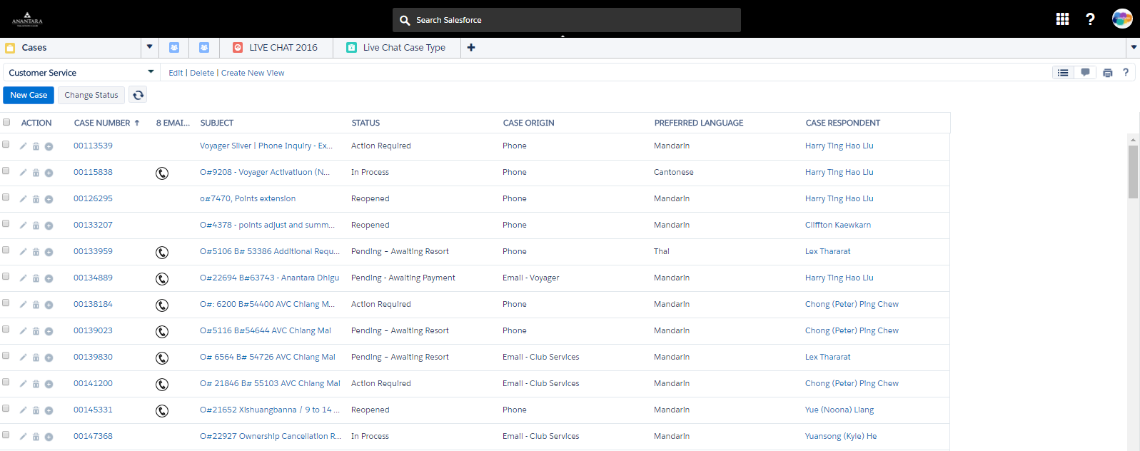
CASE Management
Alert for supervisors that a call is needed
Cases are separated based on language
Assigned to agents based on language and skill
Cases are monitored by supervisors to ensure that service levels are upheld

Slide 12
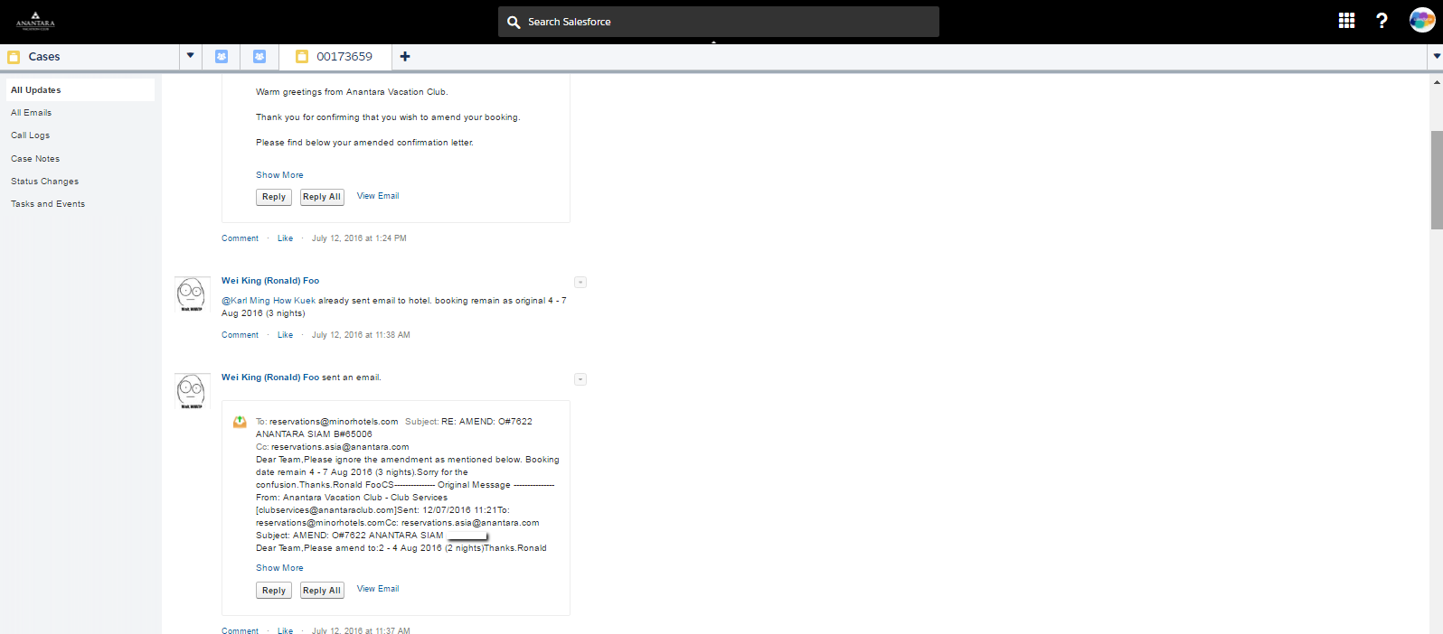
cASE FEED
Comments assist to update agents on cases and allows seamless service

Slide 13
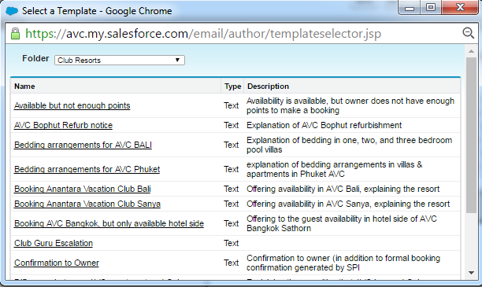
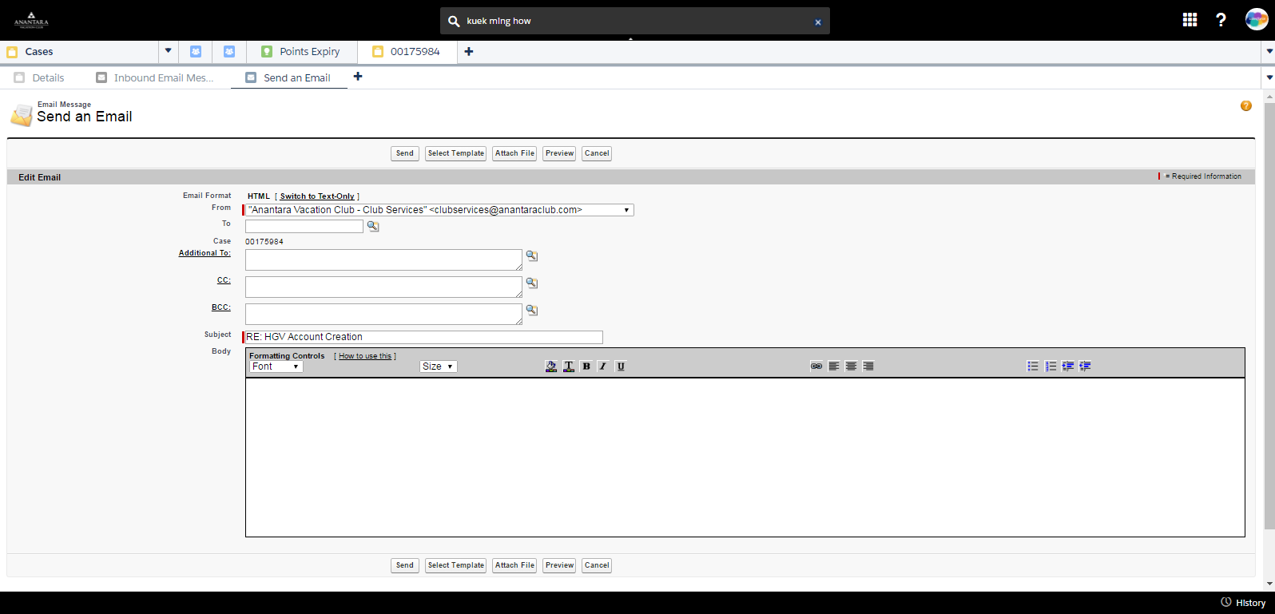
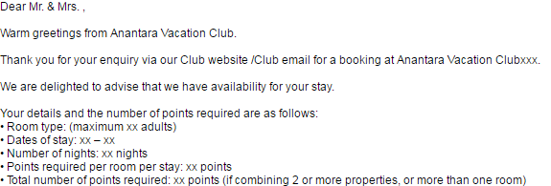
Email templates

Slide 14
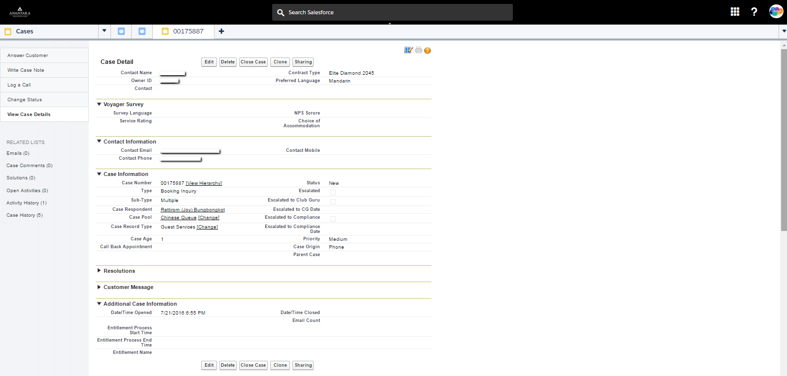
Quick escalation of cases
Quick escalation of cases at a click of a button

Slide 15
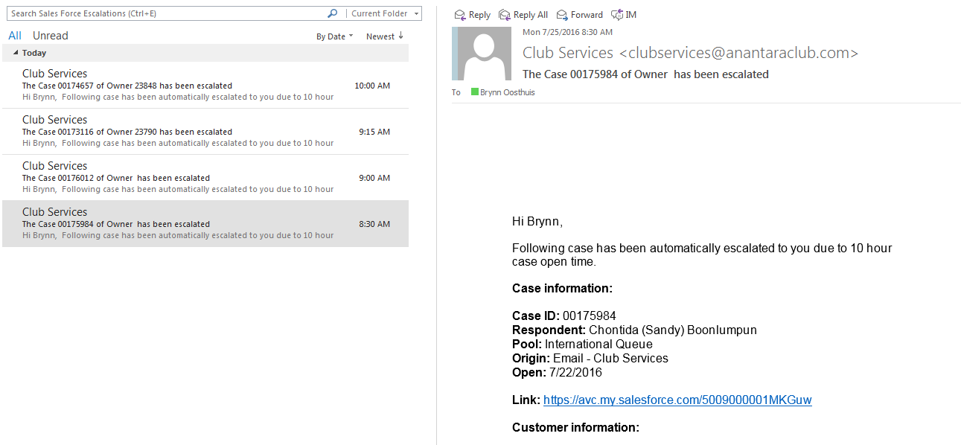
Manager alerts

Slide 16
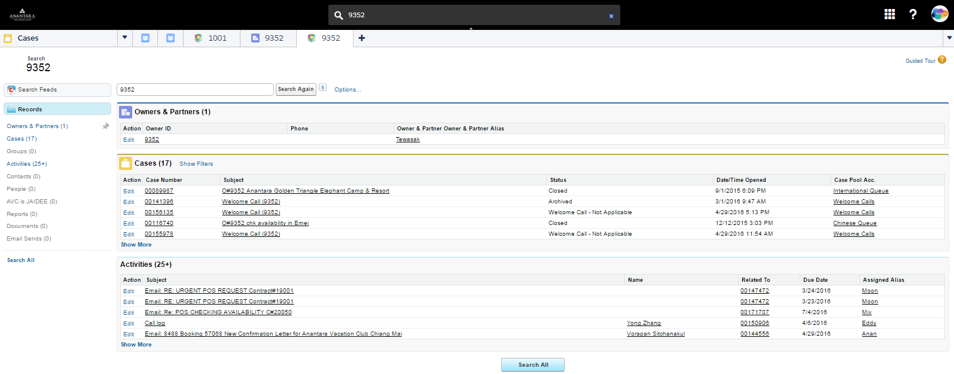
Easy searching

Slide 17
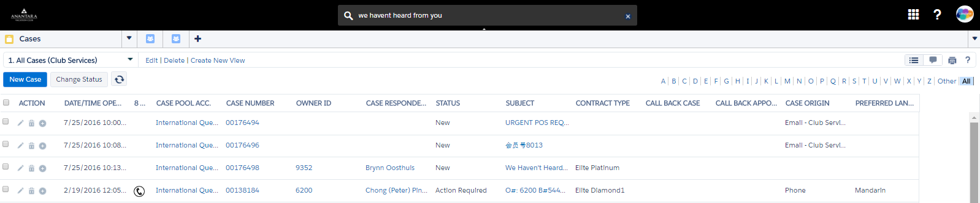
Proactive Service
Auto creation of cases

Slide 18
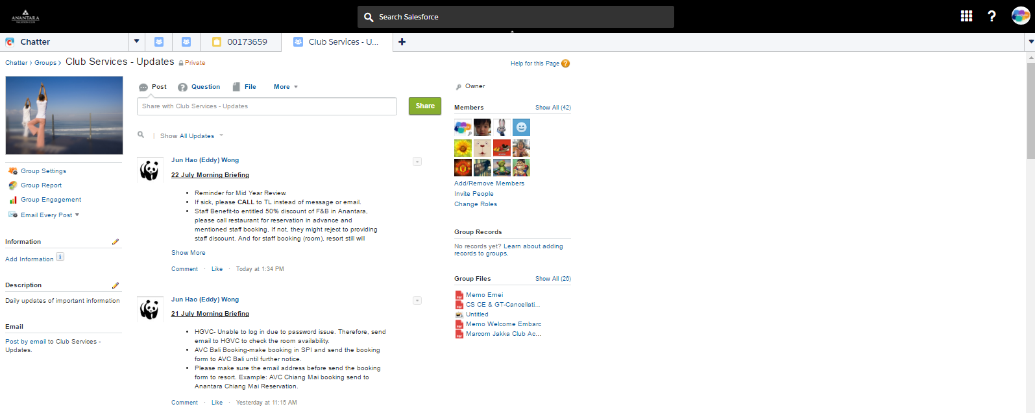
Chatter
Chatter is used to record and share updates with team members

Slide 19
New Channels

Slide 20

Live Chat
Salesforce Live Chat

Slide 21
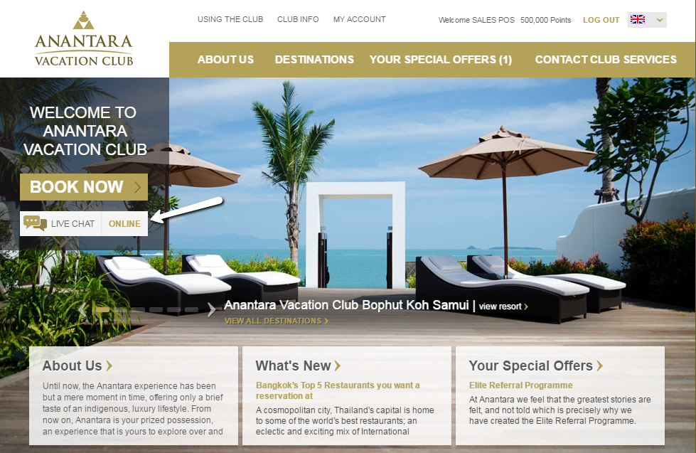
Live Chat on www.anantaravacationclub.com

Slide 22


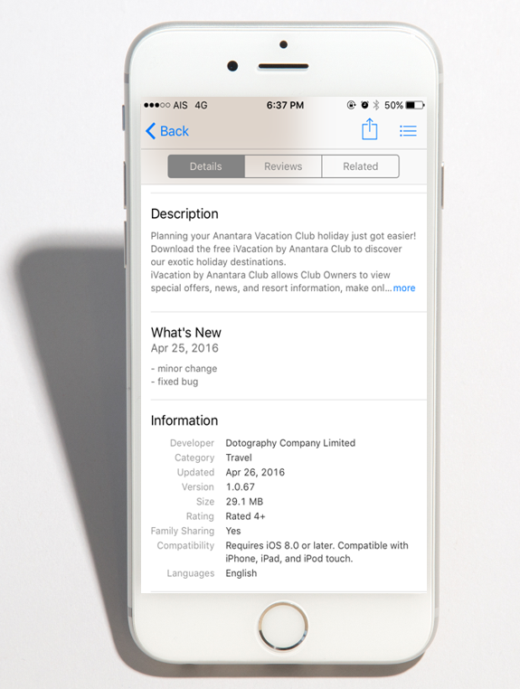
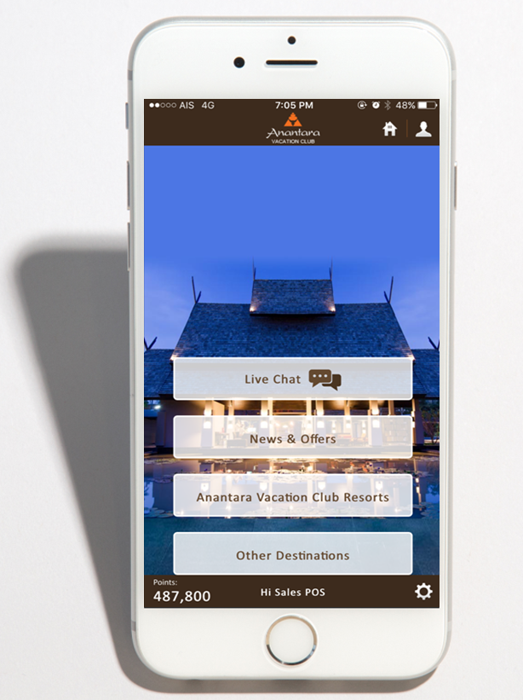
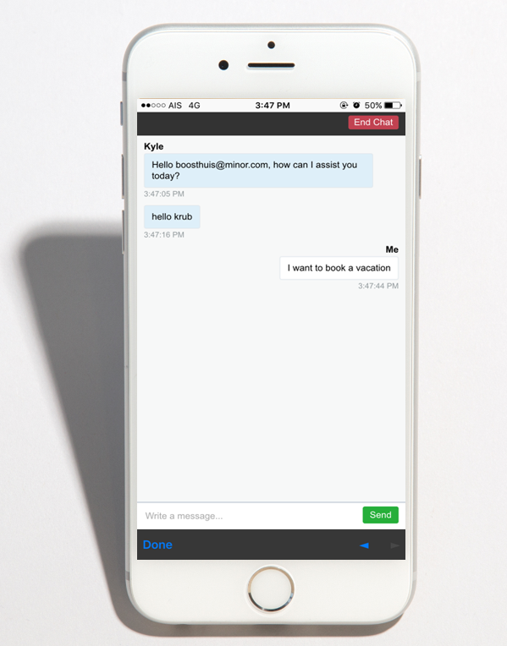
Live Chat on iVacation mobile app

Slide 23

Downloads of iVacation Mobile App on the Apple Store
650% growth!

Slide 24
Live Chats Opened by month

Slide 25
Customer feedback
“excellent customer service support. APP is functioning with immediate response followed by phone call for more effective communication and question answered instantly. excellent.”
“I chatted with your representative (Cliffton) on your web chat client. He was super helpful and resolved my booking instantly”
94% Satisfaction

Slide 26
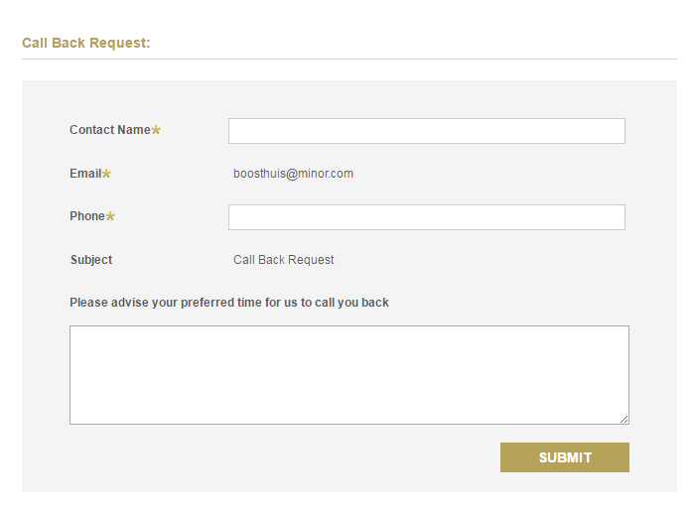
Call back requests online

Slide 27
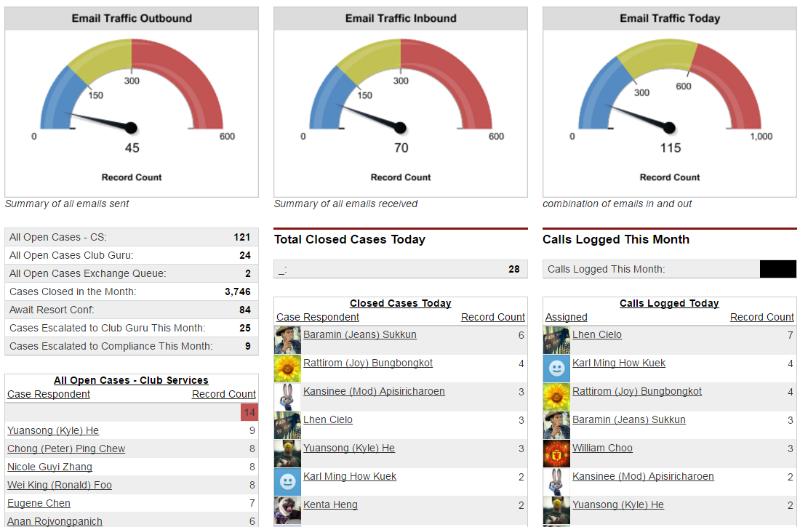
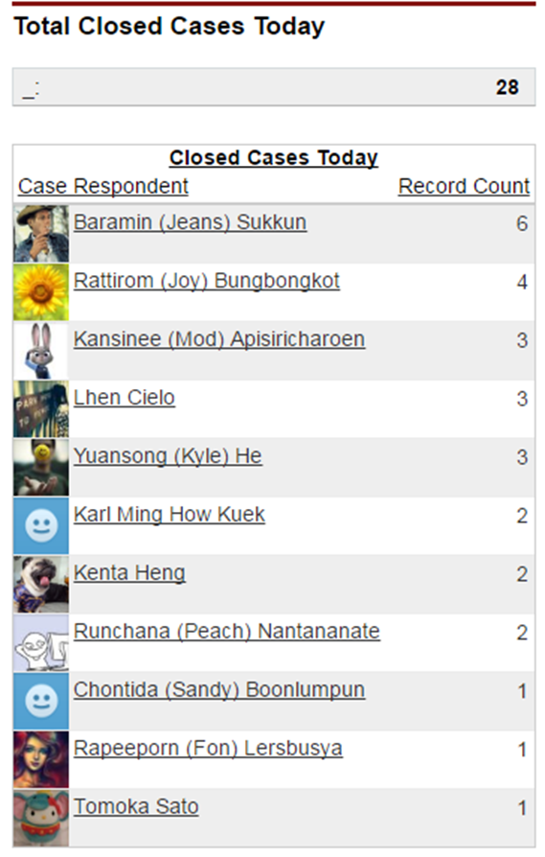
DASHBOARDS
Monitor case levels and reassign staff accordingly
Individual Performance

Slide 28
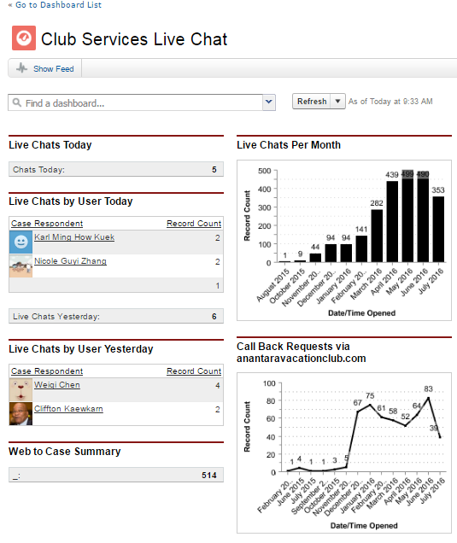
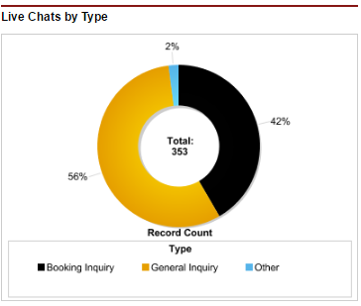
DASHBOARDS

Slide 29
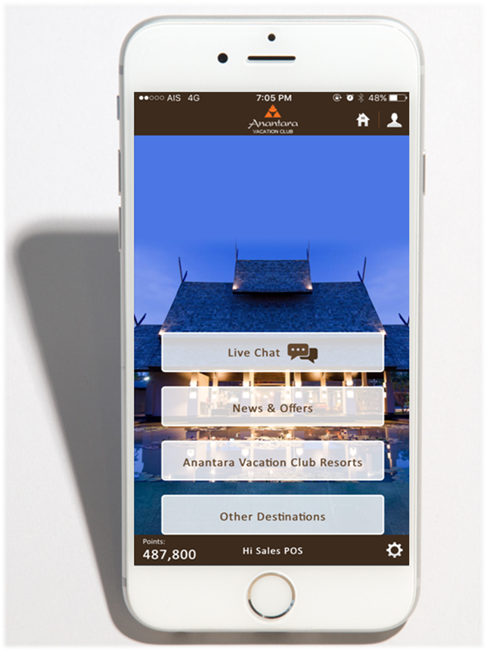
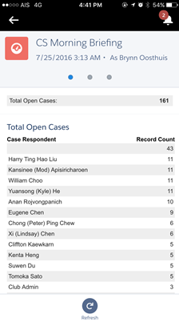
DASHBOARDS ON THE GO

Slide 30
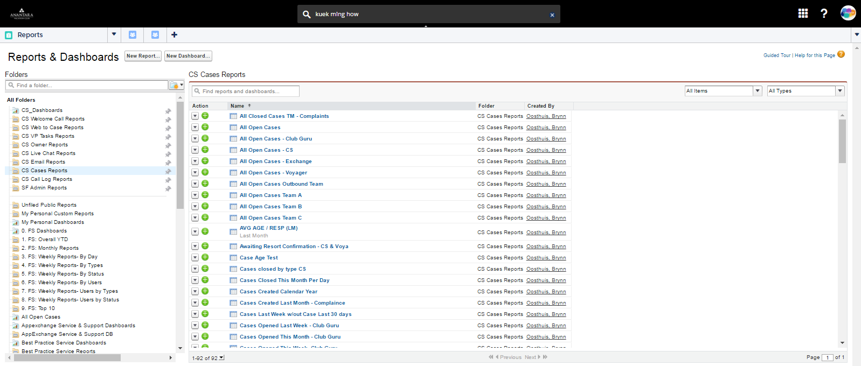
Reports

Slide 31

Success & Growth
Improved customer experience by
- Reducing the email response time from 48 hours to 4 to 6 business hours
- Reduced double handling of cases
- Fast resolution of problem cases
- Standardized answers through email templates
- Modern communication method (Live Chat)
Accurate and live reporting reducing admin tasks
Ability to recognize staff for good performance and create internal competition
Justification to higher management for increased manpower
Enhanced Internal collaboration

Slide 32
Additional Use Cases

Slide 33

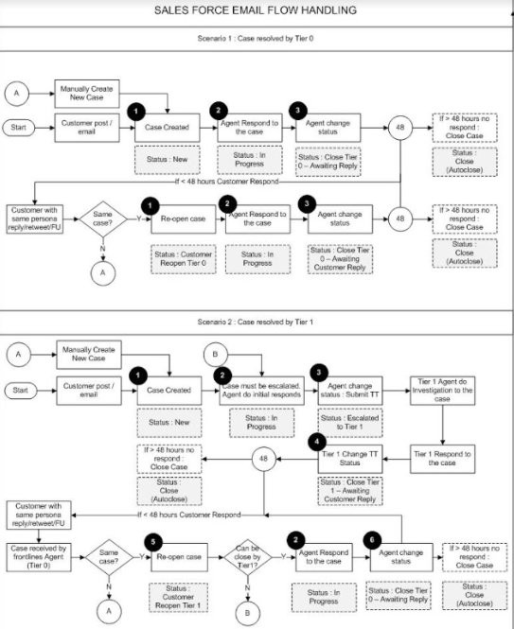
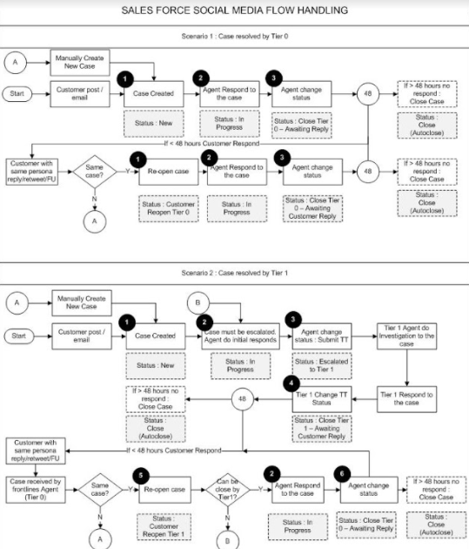
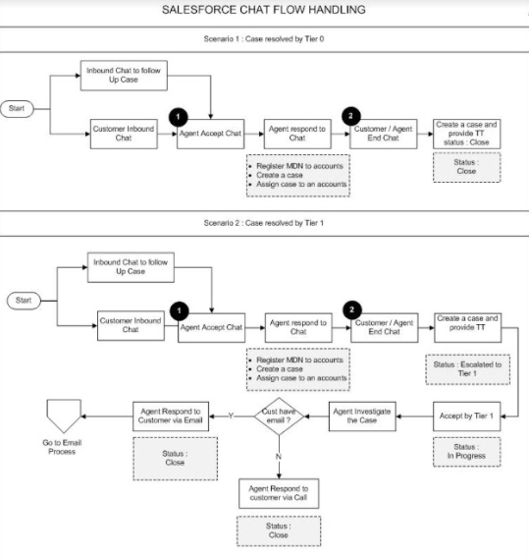

Smartfren Delivers Better and Faster Social Customer Service
Summary:
After Go-Live with our implementation, Smartfren dramatically reduced their response time from 3 hours to 14 minutes during the first day of Go-live. Customer Agents were given the ability to manage and resolve Twitter and Facebook Cases directly from Service Cloud Console. Faster case resolution and higher customer satisfaction after Social Customer Service launched.
Key Highlights:
Service Cloud Implementation
Social Customer Service
Facebook
Twitter
Live Agent
Web-to-Case
Email-to-Case
Knowledge Management

Slide 34
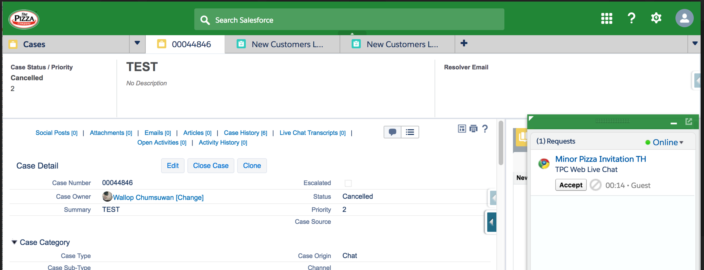
The Pizza Company Starts with Live Agent and Web to Case
Summary:
The Pizza Company wants to improve their customer experience in order to be the customer’s brand. They engaged with Beryl 8 for the implementation of Service Cloud and Marketing Cloud. Service Cloud Live Agent helps them enhance their customer service. And with Marketing Cloud, they will be able to personalize their communications for each customer, and reward loyal customers, and re-engage lapsed customers.
Key Highlights:
Marketing Cloud Implementation
Marketing Cloud Setup
Email Studio
Contact Builder and Data Sync
Journey Builder
Marketing Cloud Connect
User and Admin Training
IP Warm Up Plan
Service Cloud Implementation
Live Agent
Web to Case
User Training

Slide 35
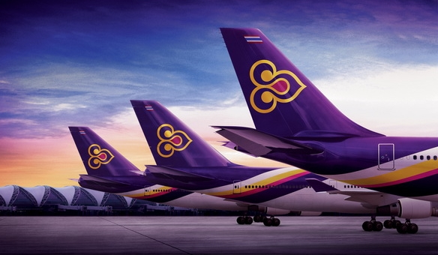





THAI Airways Improves Passenger Journey at every Touch Point
THAI Airways engaged Beryl8 for their new CRM solution initiative to better serve the passengers across various touch points through out their journeys. The solution is realized with the implementation of Service Cloud and Force.com along with custom mobile applications for cabin crew and aircraft maintenance crew for customer service and customer feedback. This initiative focuses on integrating and building a single customer profile as well as other supplementary information from various data sources to support effective incident handling connected across all touch points ensuring that the passenger experience is seamless throughout the journey with THAI Airways.
360 degrees customer profile and integrated view of customer interactions capabilities
Case management with SLA tracking and escalation rules
Knowledge base capabilities
Custom mobile application for In-Flight service operations
Custom mobile application for aircraft maintenance
Business analytics through Report and Dashboard capabilities
Collaboration through Chatter

